Slide 1
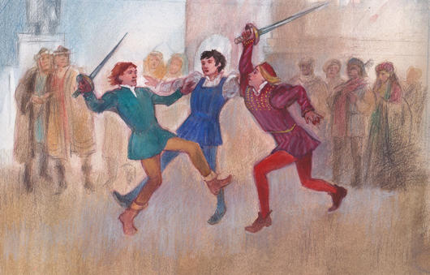
Act 1, Scene 1: Lovesick Romeo and the Prince’s Decree
Stop in the name of love!
He started it!
But he bit his thumb at me!
We have already seen how the play opens in the prologue, with key themes such as love and hate introduced to the audience by the chorus. We have also seen the use of ANTITHESIS in the prologue to encapsulate this key opposition in the play. We now plunge into an opening scene of VIOLENCE on the streets of Verona.

Slide 2
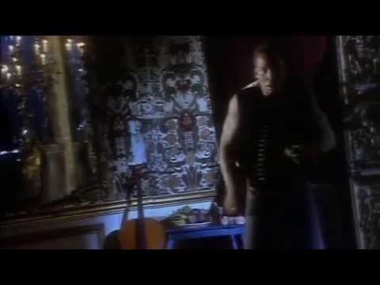
Act 1, Scene 1: Romeo and Love
What is Love in the 21st century?
Answer this question before the music stops!
Start like this:
In the 21st century, love is…

Slide 3
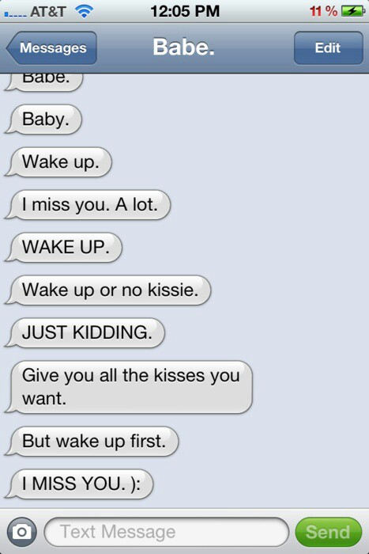
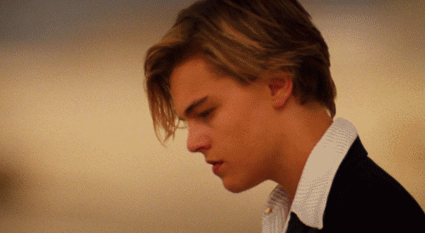
Act 1, Scene 1: Romeo and Love
Romeo is “lovesick”
But...what even is love?

Slide 4
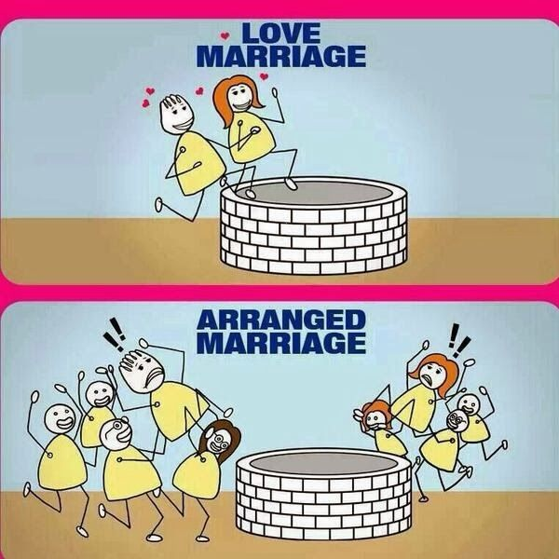
Act 1, Scene 1: Romeo and Love
What is Love in 2023?
In our culture we’re accustomed to the notion that marriage is based on romantic attachment resulting from physical attraction and intimacy. Love is a prelude to marriage- a legally recognised status (but only for hetrosexuals until recently). One ‘rule’ is that we remain monogamous.
Where do we see this in the play?
However, this hasn’t always been the case, and as we know from living in a multicultural society, people from other cultural traditions have different attitudes to marriage and relationships between the sexes.
Arranged marriages based on money, land and power used to be common place among the ruling classes - ‘love’ didn’t come into the equation.

Slide 5
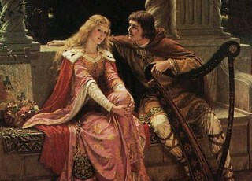
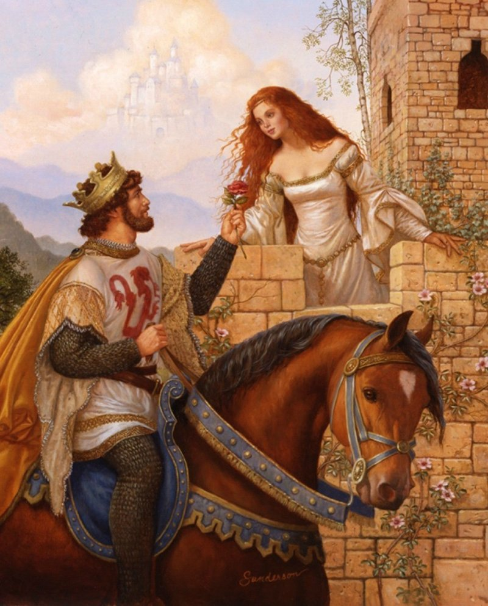
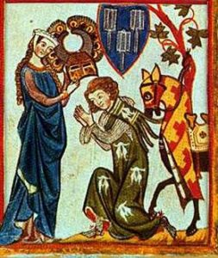
Act 1, Scene 1: Romeo and Love
What was love in the past?
Courtly Love was a medieval tradition in which members of the upper class engage in love affairs according to specific rules of behaviour.
The phrase "courtly love" is a modern scholarly term to refer to the idea espoused in medieval French as "Fin Amour." This phenomenon is a cultural trope in the late twelfth-century, or possibly a literary convention that captured popular imagination.

Slide 6
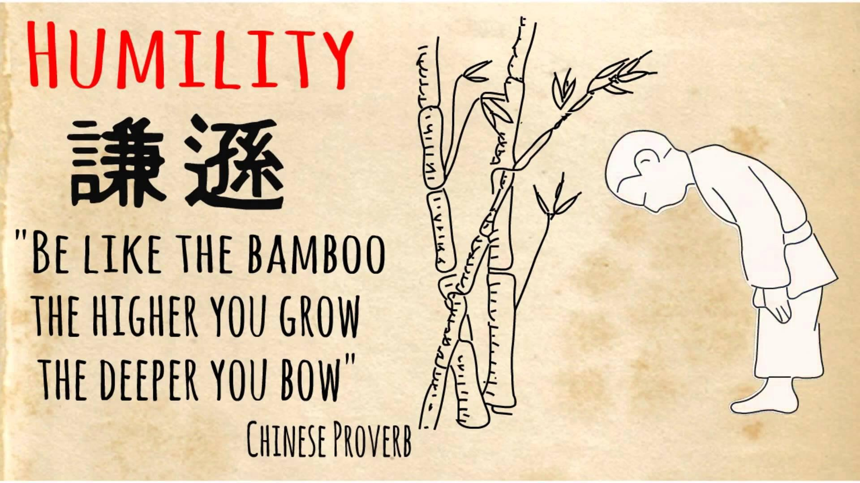
Act 1, Scene 1: Romeo and Love
HUMILITY
A man should be subservient to a woman, who treats him like a slave. The man is downcast and despairing.

Slide 7
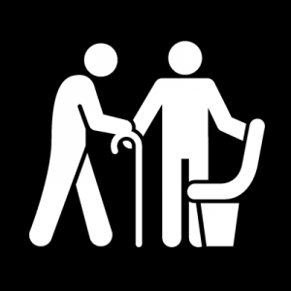
Act 1, Scene 1: Romeo and Love
COURTESY
Love can only be felt by the ‘courteous’, therefore it is confined to the well-bred, Upper classes. Working class people cannot feel love.

Slide 8
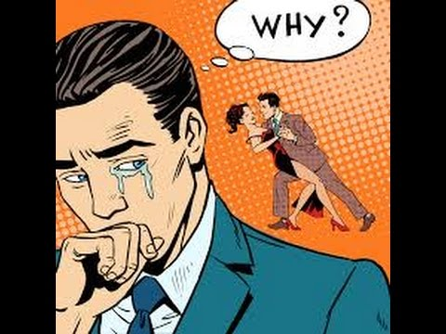
Act 1, Scene 1: Romeo and Love
ADULTERY
Men should only fall for women who are unobtainable, such as another man’s wife. Maybe someone beyond their means ($). Perhaps even someone out of bounds.

Slide 9
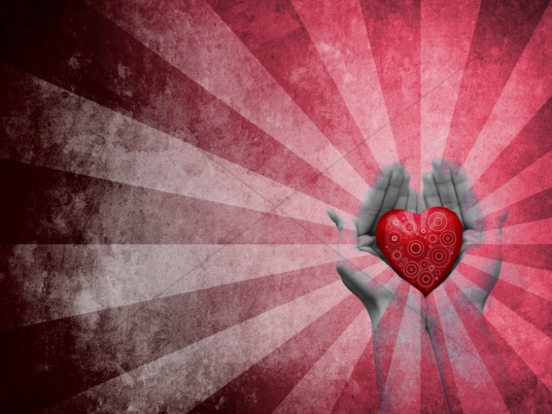
Act 1, Scene 1: Romeo and Love
RELIGION OF LOVE
Anyone suffering from the pain of love is saved from complete despair by faith in the God of Love, who unlike heartless partners never betrays his followers.

Slide 10
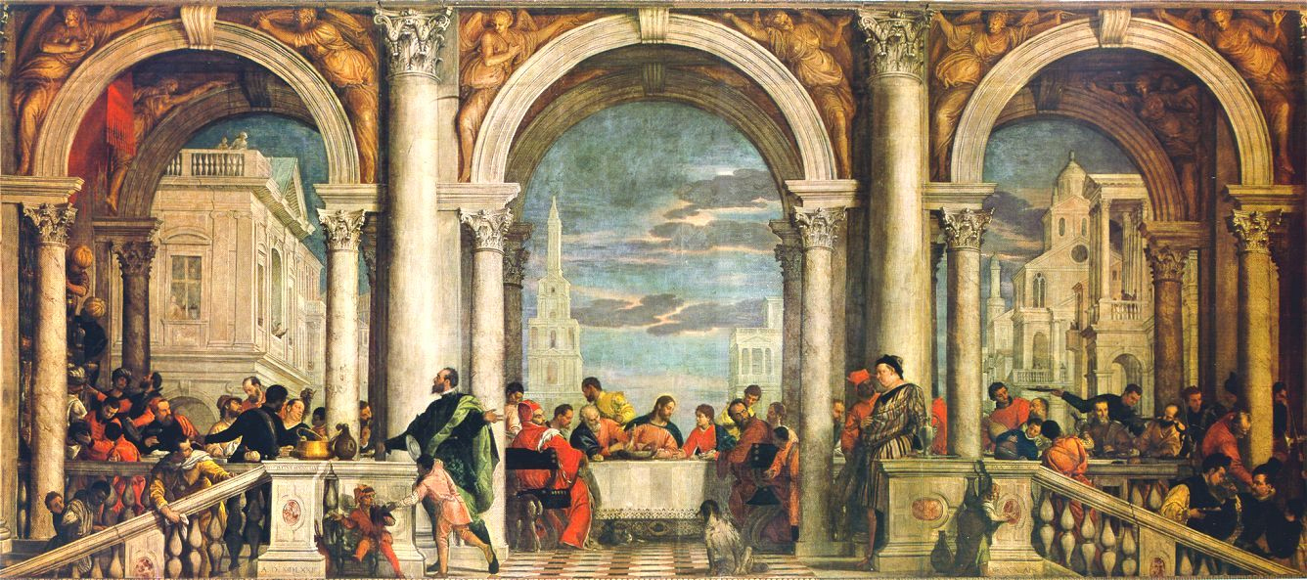
Act 1, Scene 1: Romeo and Love
If all of those things were true, what kind of a society would we be living in?
A Renaissance One! (between the 14th and 17th centuries)
Romeo and Juliet is estimated to have been written about 1594–96 although the story is much older!
(Yes, it wasn’t Shakespeare’s idea!)

Slide 11
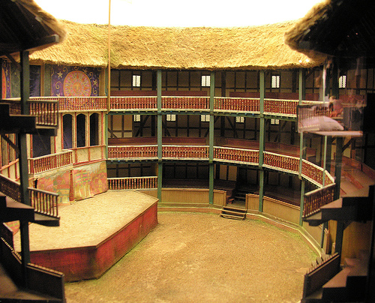
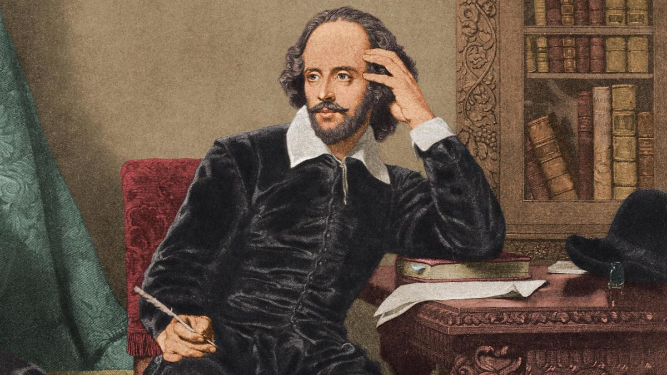
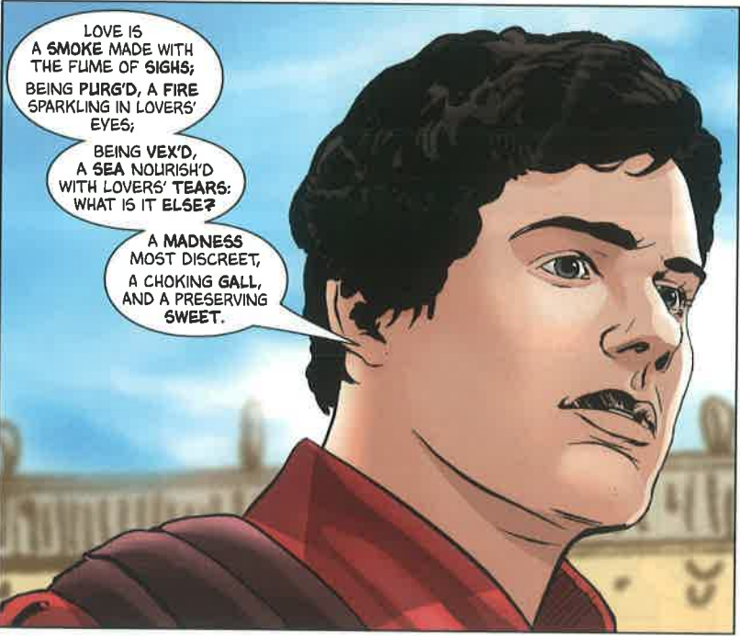
Shakespeare is not really remembered for his plots. Today’s audiences mostly focus on plot- twists, turns etc. often are the most important detail in a narrative.
But Shakespeare is famed for 3 main reasons:
Shakespeare’s Genius?
The beauty and control of his verse. Most of his plays are a form of poetry and his contribution to language is unparalleled.
Try writing two lines of Iambic Pentameter whilst also trying to say something meaningful. It’s hard. Shakespeare’s plays have almost 120,000 lines!
His ability to play with form and conventions. His audiences were far more aware of the conventions of poetry and tragic/comic theatre than most people today. But he was just as able to please the commoners as he was the rich and intellectual.
Can you think of any modern examples of stories that are both critically and commercially successful? That subvert audience’s expectations of genre and form?
His timeless characters. They may speak funny but his characters are as relevant and recognisable today as they were then.
Do you honestly not know anyone who has never been a bit like Romeo in this scene? I have met many introspective Hamlets, ambitious Macbeths, cunning Iagos, jealous Othellos, naive Mirandas, regretful Lears, stupid Bottoms and foolish Polonius’s in my time, as I’m sure you all will too.

Slide 12
What is an oxymoron?
Act 1, Scene 1: Romeo and Love
Oxymoron:
A figure of speech where contradictory/ opposite-sounding words are used together.
Example:
They have a love-hate relationship.
LO: To identify oxymora and explore what these reveal about Romeo’s character

Slide 13


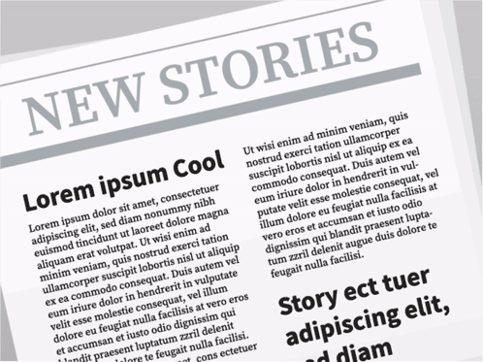
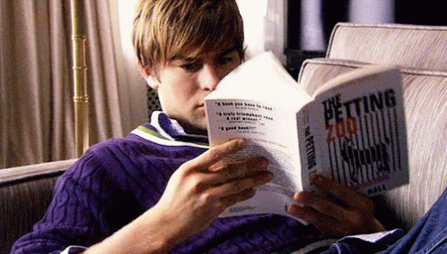
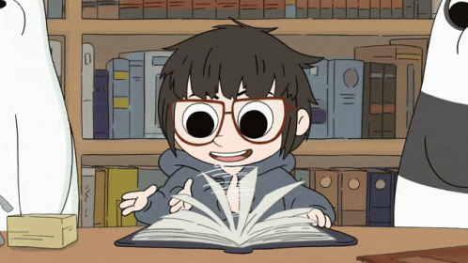
Act 1, Scene 1: Romeo and Love
Task: Using your highlighter, what oxymorons can you find in his speech? Highlight and label them.
What examples have you found?
Why does Shakespeare use oxymorons here?
LO: To identify oxymora and explore what these reveal about Romeo’s character

Slide 14
ROMEO
Alas, that love, whose view is muffled still,
Should, without eyes, see pathways to his will!
Where shall we dine? O me! What fray was here?
Yet tell me not, for I have heard it all.
Here's much to do with hate, but more with love.
Why, then, O brawling love! O loving hate!
O any thing, of nothing first create!
O heavy lightness! serious vanity!
Mis-shapen chaos of well-seeming forms!
Feather of lead, bright smoke, cold fire, sick health!
Still-waking sleep, that is not what it is!
This love feel I, that feel no love in this.
Dost thou not laugh?

Slide 15
ROMEO
Alas, that love, whose view is muffled still,
Should, without eyes, see pathways to his will!
Where shall we dine? O me! What fray was here?
Yet tell me not, for I have heard it all.
Here's much to do with hate, but more with love.
Why, then, O brawling love! O loving hate!
O any thing, of nothing first create!
O heavy lightness! serious vanity!
Mis-shapen chaos of well-seeming forms!
Feather of lead, bright smoke, cold fire, sick health!
Still-waking sleep, that is not what it is!
This love feel I, that feel no love in this.
Dost thou not laugh?
Contradictions and confusion, highlighting emotions and feelings of the character through oxymoron expressions
Oxymoron
Theme of antithesis
Opposing forces →
Opposing factions (capulets, Montagues)
Opposing lovers
Opposing ideals

Slide 16
Act 1, Scene 1: Romeo and Love
(5 min) Discuss with the person next to you!
THINK, PAIR, SHARE
1: Which oxymoron do you think is the most effective?
The oxymoron I think is the best is… “_______”
I think this because it describes….
2: Why do you think he has used so many oxymorons in his speech?
3: What do you think Romeo is saying about how love works? Do you agree?
LO: To identify oxymora and explore what these reveal about Romeo’s character

Slide 17
PETAAL PRACTICE
Act 1, Scene 1: Romeo and Love
Write a paragraph answering this question:
What does Romeo’s language tell us about what he thinks about love?
In Act I, Scene I
Romeo uses many oxymorons in his description of love.
An example of this is when he says…
This shows audiences that Romeo thinks love is…
Shakespeare is also trying to show the audience that through his use of language, Romeo can be judged as....
LO: To identify oxymora and explore what these reveal about Romeo’s character

Slide 18
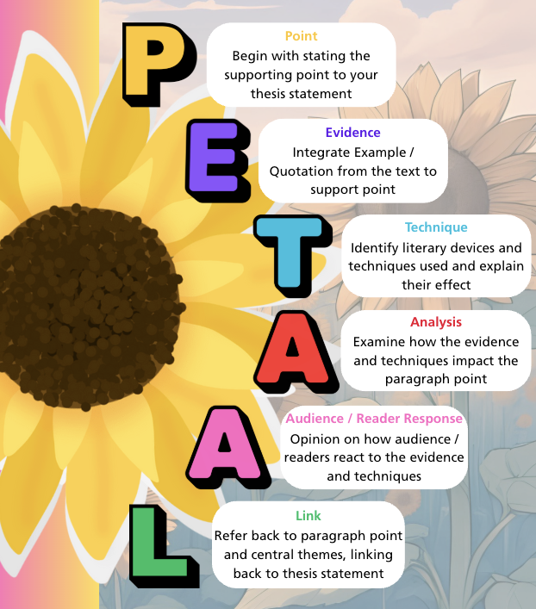

Act 1, Scene 1: Romeo and Love
Sentence Starting Structure Examples
Shakespeare explores elements of…
A key theme highlighted in Romeo and Juliet is…
This is shown when Romeo proclaims how “Quote”...
The [language device]
demonstrates…
vividly portrays…
communicates…
showcases a sense of…
Handwrite
LO: To identify oxymora and explore what these reveal about Romeo’s character

Slide 19
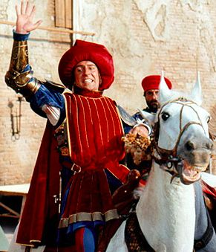
The Prince’s Decree
Why does he declare a new law on fighting in the streets?
Stop the fighting
Ending violence
Prevent further bloodshed
Containing the chaos and restoring order
Anger at the Capulet and Montague feud
Stop further escalation of conflict
Threatened both houses with penalty of death
Prioritising the safety of the citizens of Verona
For peace in Verona
Traditional warnings do not work
“Rebellious subjects, enemies to peace”
- Prince Escalus 1.1.72 (page 9)
The Capulets and the Montagues have gone too far this time. Traditional warnings do not seem to work on those two feuding fools, who cannot see past their grudges.

Slide 20
The Prince’s Decree
How would you describe a ruler like Prince Escalus?
Imperious
Princely
Regal
Reigning Sovereign
Powerful
Judicious
Authoritative
Stately
Peace-broker
Leader
“Quench the fire of your pernicious rage”
- Prince Escalus 1.1.75 (page 9)
With power and authority as the Prince of Verona, I imperiously declared, “On pain of death! There will be no more fighting in the streets of Verona!”

Slide 21
The Prince’s Decree
What emotions does Prince Escalus feel?
Angry
Righteous
Furious
Perplexed
Passionate
Grief-stricken
Irritated
Enraged
Displeased
Vexed
“If you ever disturb our streets again, / Your lives shall pay the forfeit of the peace”
- Prince Escalus 1.1.87-88 (page 9)
As I rode through the streets with my royal guard escort, I was both enraged and grief-stricken. The chaos of the fighting had resulted in so many lives lost.

Slide 22
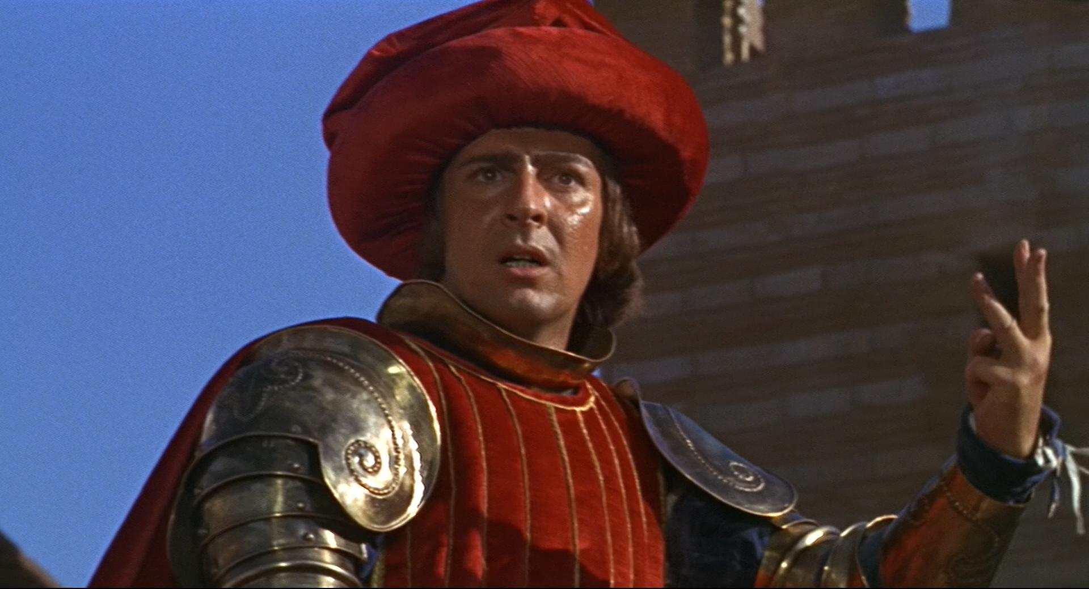
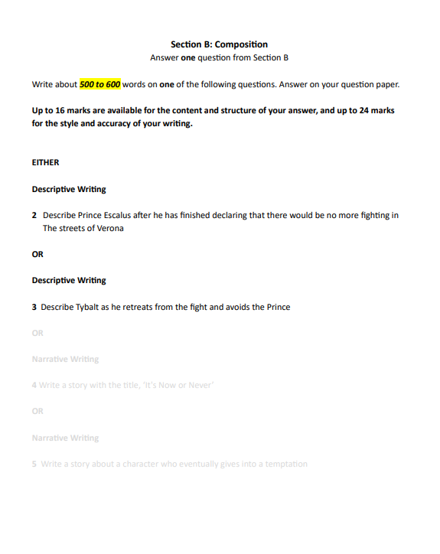

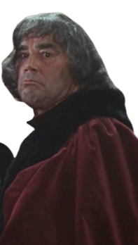
The Prince’s Decree
What emotions does Prince Escalus feel?
Why does he declare a new law on fighting in the streets?
Angry
Righteous
Stop the fighting
Ending violence
Furious
Perplexed
Prevent further bloodshed
Containing the chaos and restoring order
Passionate
Grief-stricken
Anger at the Capulet and Montague feud
Stop further escalation of conflict
Irritated
Enraged
Threatened both houses with penalty of death
Prioritising the safety of the citizens of Verona
R&J Descriptive
Displeased
Vexed
For peace in Verona
Traditional warnings do not work
How would you describe a ruler like Prince Escalus?
Imperious
Princely
Now have a go at articulating the emotions of someone in the audience of the Prince’s decree
Regal
Reigning Sovereign
I am Lord Capulet at the moment when the Prince gravely declares a new law in Verona in Act 1, Scene 1. These are my thoughts and feelings:
Powerful
Judicious
Authoritative
Stately
Peace-broker
Leader

